Slide 1
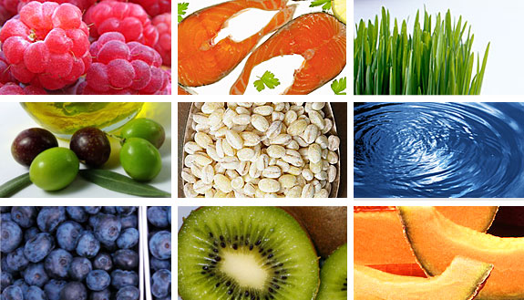
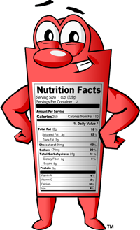
Nutrition Facts

Slide 2
Serving Size
French Fries
Reading the label starts here
ALL the numbers are based on one serving size.
The package might actually contain several servings.
This is very important information.
This will help you with portion control.
Think
about it!
What are some reasons people could be confused about serving sizes?

Slide 3
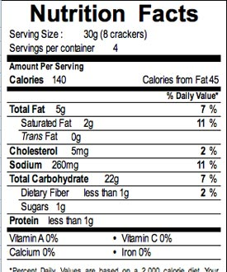
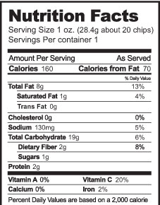
Servings per Container
Crackers
Tells you how many servings in that package.
Goes hand in hand with Serving Size.
Some are low in calories and fat if you only have one serving.
If you eat more than one then calories and fat can really add up!
How would you choose between two different boxes of the same type of food?
Do you have enough information to make a good decision?

Slide 4
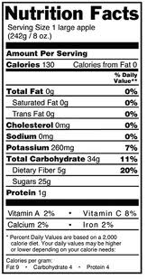
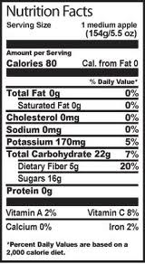
Calories
Apples
This tells you how much energy you will get from one serving of this food.
If you don’t use up that energy it gets stored as fat.
What can you do to make sure your calories burn off?
How can you keep track of your calories going in and out?

Slide 5
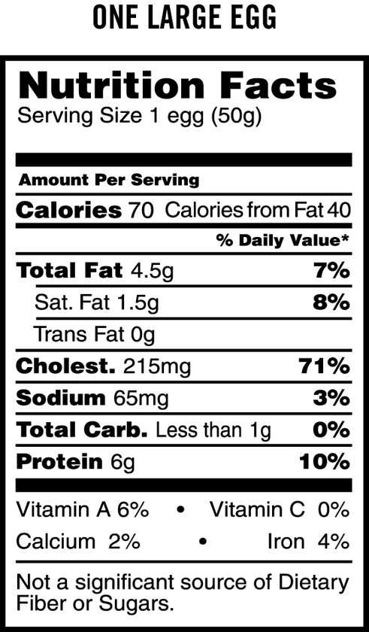
Calories from Fat
This tells you how much energy of that food comes from fat.
Your heart likes food lower in fat.
Make a
Prediction
Which kind of fat is the worst fat for your body?

Slide 6
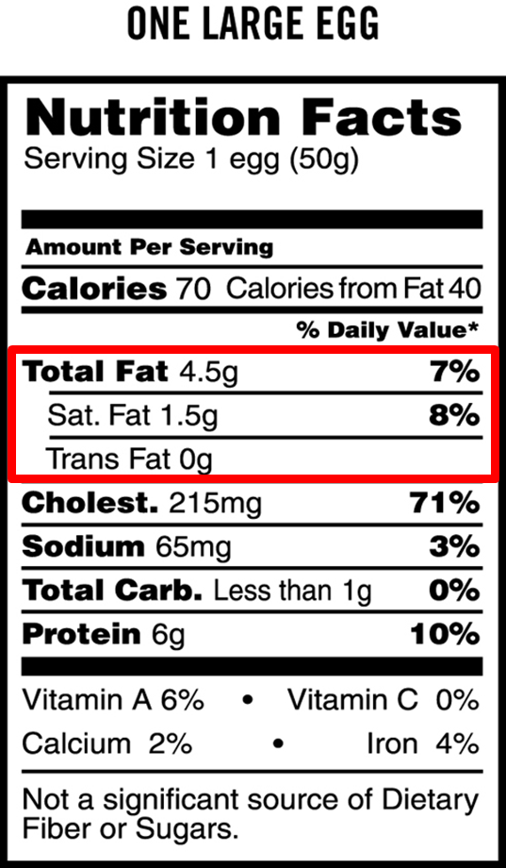
Total Fat
This is the amount of ALL the different kinds of fat in one serving.
Your body needs some fat.
Avoid foods high in saturated fat and look for zero trans fat.
These fats are not good for your heart.
Answer
Trans fat is the worst type of fat for your body. This is the fat found in fried foods like french fries and fried chicken.

Slide 7
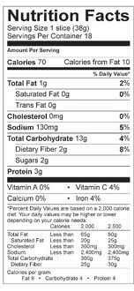
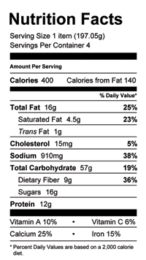
Percent Daily Value (%DV)
Whole Wheat Bread
Grilled Cheese & Fruit Sandwich
This is a number on the label given in percentages.
These percentages are the amount of a certain nutrient that a person will eat in one serving.
This is based on a 2,000 calorie diet.
How do you know when you have had enough of a nutrient?
What should you do if you eat more than one serving?

Slide 8
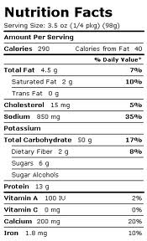
Cholesterol & Sodium
Cottage Cheese
Tells you how much of that nutrient is in one serving.
Pick foods that are low in cholesterol and sodium (salt).
Look for 5% or less.
Kraft Mac & Cheese
Does watching your cholesterol and sodium help your heart?
How would watching your cholesterol and sodium help your heart?

Slide 9
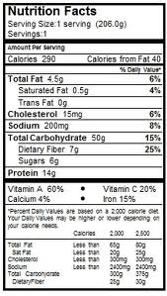
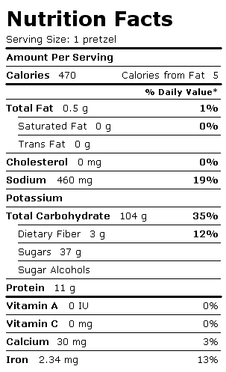
Carbohydrates
Whole Wheat Pasta
Auntie Annes Glazin' Raisin Pretzel
Choose the best sources of carbohydrates—whole grains (the less processed, the better), vegetables, fruits and beans.
Carbs provide fuel for the body.
Given the information above, which food would be a better source of nutrition?

Slide 10
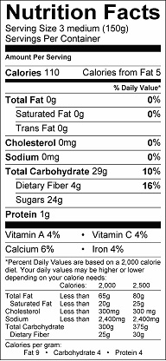
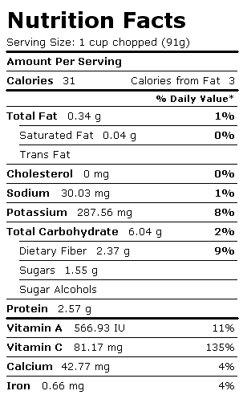
Fiber
Figs
This tells you how much fiber is in one serving.
Fiber helps your food move through your body easily.
Foods with 4 grams or more are high in fiber and are good for you.
Broccoli
Do you think it is more important for adults to have more fiber than kids?
Why or Why not?

Slide 11
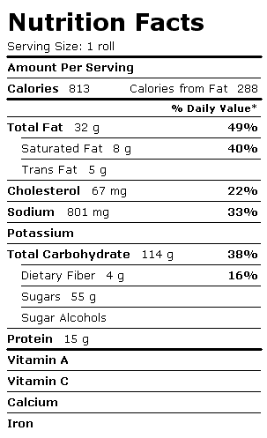
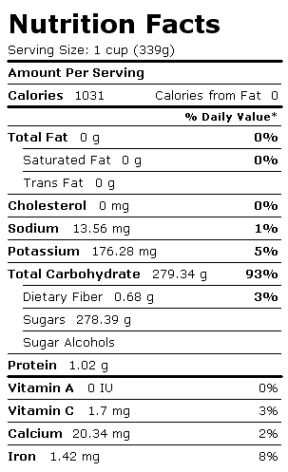
Sugars
Cinnabon Classic Cinnamon Roll
This is the total amount of natural sugar and added sugar that is in one serving.
Our bodies do not need too much sugar,
Sugar can add a lot of calories that we do not need.
Honey
Is there a connection between sugars and carbohydrates?
What is the difference between a sugary snack like the Cinnabon and a natural sugar like honey?

Slide 12
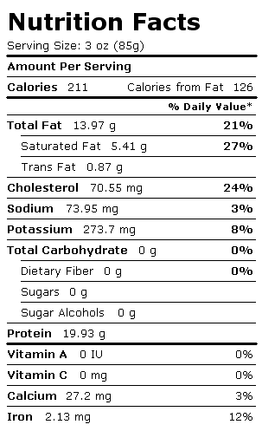
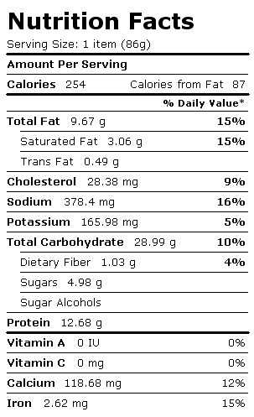
Protein
Hamburger
Home VS Fast Food
This is very important because it is the building blocks for all cells.
Read carefully!
High protein foods can be high in fat.
Compare the two hamburgers.
What could be reasons for the difference in nutrition information between them?
Talk about it!

Slide 13
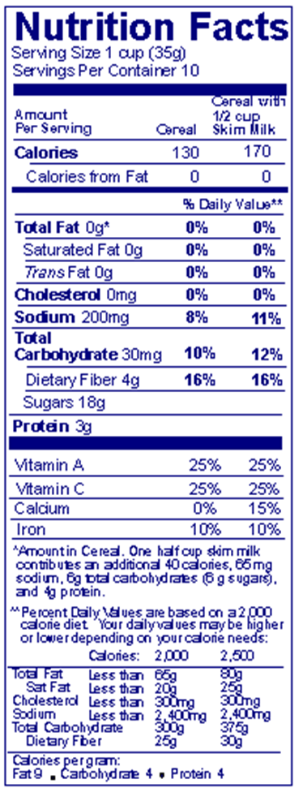
Vitamins
Cereal
Vitamins help your body stay healthy
20% or more is high and makes your body very happy!
Which types of foods would have a higher vitamin percentage?
Which types of foods would be better choices for your body?

